Slide 1


TERNA ENGINEERING COLLEGE
DEPARTMENT OF COMPUTER ENGINEERING
COLLEGE-ASSIST APPLICATION
[COLLEGE-MATE]
UNDER THE GUIDANCE OF :
Prof. Rohini Palve.
Project members :
C-19: Sumit P. Mote.
C-29: Harsh A. Minde.
C-36: Vedant P. Tambe.
ACADEMIC YEAR: 2023-24

Slide 2
INDEX
ABSTRACT
INTRODUCTION
LITERATURE SURVEY
PROBLEM STATEMENT & OBJECTIVE
SCOPE
PROPOSED SYSTEM
HARDWARE & SOFTWARE USED
PROJECT FLOW
CONCLUSION & FUTURE SCOPE
REFERENCE

Slide 3
ABSTRACT
A College Application can be one of the most integral part of any degree college, as it is a system which makes it possible for students to directly connect with faculties, upcoming events, companies for interview and placements, etc.
Training and Placement module is a leading step in automating the very much manual and tedious task of training and placement department.
This System can be used as a central depository which controls/posses the entire data of student academic details.

Slide 4
INTRODUCTION
In 21st century where mobile and information technology has become an integral part of our lives, use of Internet to enable students, faculties and TnP cell to manage the events, notices, placements, etc. with active participation of faculties and Training and Placement Officer (TPO) can be eased in educational institutes.
A college has various offline commities that connects students and firms visiting the college campus or spreading event notices, keeping student record and also TnP activities are carried out.
“College-Assist Application: College-Mate" emerges as the solution to this problem.
It is a user-friendly mobile application that connects the college as a hole with the Students and helps promote events, student queries, placement drive and may also help to improve the chances of placement.

Slide 5
LITERATURE REVIEW
Sr. No. | Project Title | Author | Publishing Date | Summary
1. | Online Training and Placement System | Gunjan Jewani, Swati Sahare | May 2023 | Automate placements using Naïve Bayes Classifier
2. | “PlaceIn” : Android Application for Student Placement System | Vivendra Yadav, Tushar Shende | June 2019 | Detailed study on app development for online placements
3. | College Management System | Aditya Shelar, Sudarshan Sawant | May 2023 | PHP and MySQL based project implementing Library of institution in Application.
Sr. No.
Project Title
Author
Publishing date
Summary

Slide 6
LITERATURE REVIEW
Sr. No. | Project Title | Author | Publishing Date | Summary
4. | IOS and Android Application for Training and Placement Department | Akshay Thete, Rucha Chaudhary | June 2021 | IOS and Android App having a central depository for all student and placement data
5. | College Management Android Application | Shwetashree A, Bapuram Ramesh Rohith | July 2022 | Implemented using Android Operating System and having Circular Information.
6. | Android Based Campus Solution for College Management System | Niharika Dedhia, V. C. Kotak | November 2017 | Implemented Voice Messaging Module
Sr. No.
Project Title
Author
Publishing date
Summary

Slide 7
LITERATURE REVIEW
Sr. No. | Project Title | Author | Publishing Date | Summary
7. | Design and Implementation of College Student Information Using Android Application | Swapnali Awhad, Trupti Bade | July 2020 | This Android application manages powerful data and has easy Interface.
8. | Placement Management System | Farheen Taqi Rizvi, Naushin Arif Khan | January 2021 | Web App. to authorize users, allow eligible student to apply for placement. File System and automation.
9. | College Placement Recruitment system using Android App | Aarti J. Auti, Varsha N. Pabale | November 2023 | Implementing Career Services, Application Tracking, Interview Scheduling
Sr. No.
Project Title
Author
Publishing date
Summary

Slide 8
PROBLEM STATEMENT & OBJECTIVE
PROBLEM STATEMENT :
A better source for Students to be updated about Events and notices and Placement cells are vital in every college, as a student chooses college based on its placement record, campus and events.
The challenges encountered by current system is that the students data is sorted manually and filtering students as per eligibility criteria is a difficult task.

Slide 9
OBJECTIVE :
Handle the details of events, placement, students, skills, faculties, training, etc.
User friendly interface
Lessen the manual effort required in managing all committees, student data and TnP cell.
To provide upto date knowledge to students about upcoming events, placement drives, visiting companies, etc.

Slide 10
SCOPE
Students can access previous information about faculty, campus, events, alumni, placements, etc.
Students can have access to latest events and notices and also the skills needed/ developed for campus recruitment.
Students are kept updated about the upcoming events, programs, exams, visiting companies in the campus and their eligibility criteria.
The main scope of the project is to convert all the tedious manual work of all the committees, official staff and TnP Cell into an user-friendly application using which they can easily reach out to students.

Slide 11
PROPOSED SYSTEM
1) Guest Module:
Available to the users to keep everyone informed about latest campus updates and events.
2) Student Module:
The initiative gathers all essential information about student, his skills, grades, upcoming events, notices, placement opportunities in one place, making it easy for students to access.
3) T&P Module:
The administrator of this system is Admin. He is able to upload the student’s necessary materials and placement relative notices and instructions.
4) Event and Activities Module:
This module's primary goal is to update users with the latest events and programs scheduled and notices related to them.

Slide 12
HARDWARE & SOFTWARE USED
Hardware requirements :
Processor: Intel Core i5
RAM: 16 GB or More
Operating System: Windows 11
Smartphone with minimum API level of 21.
Smartphone with minimum 2GB RAM.
Software requirements:
Flutter
Android Studio (latest version)
Android SDK (Software Development Kit)
Firebase Authentication
Firebase Database

Slide 13
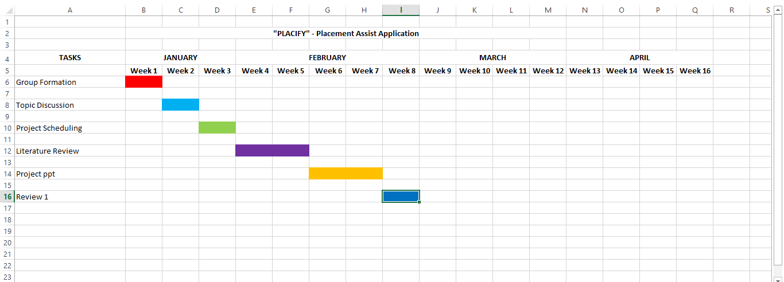
TIMELINE CHART

Slide 14
PROJECT FLOW
In General:
Admin
(Maintain)
Student Module
Login/Register
T&P Module
Student
(View)
Event & Activities Module
APP
.
.
.
.
.
College Module
Guest

Slide 15
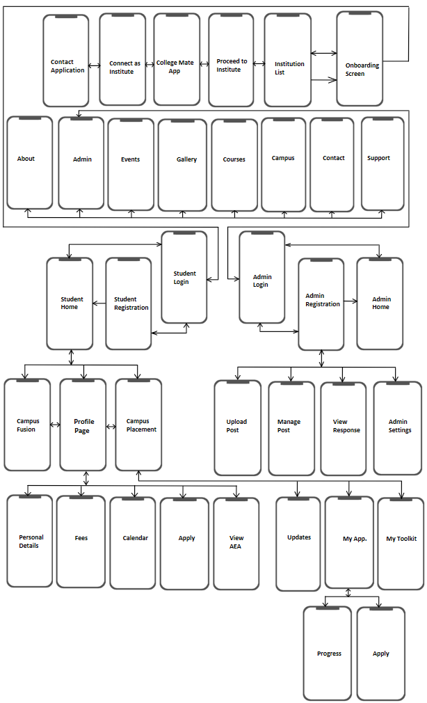
SOFTWARE ARCHITECTURE:

Slide 16
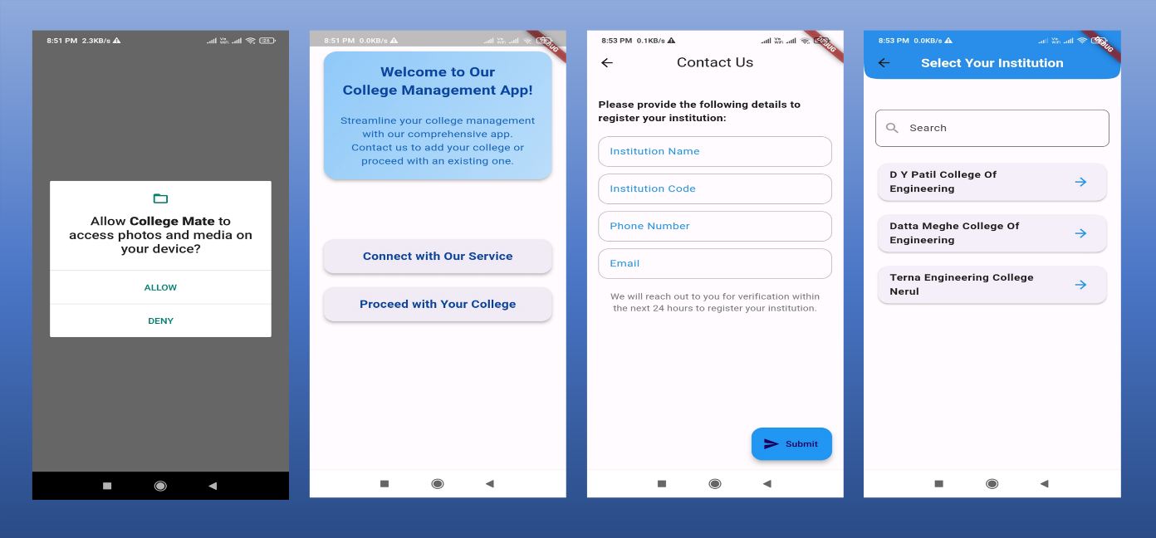
APP SCREESNSHOTS
Opening Screens:

Slide 17
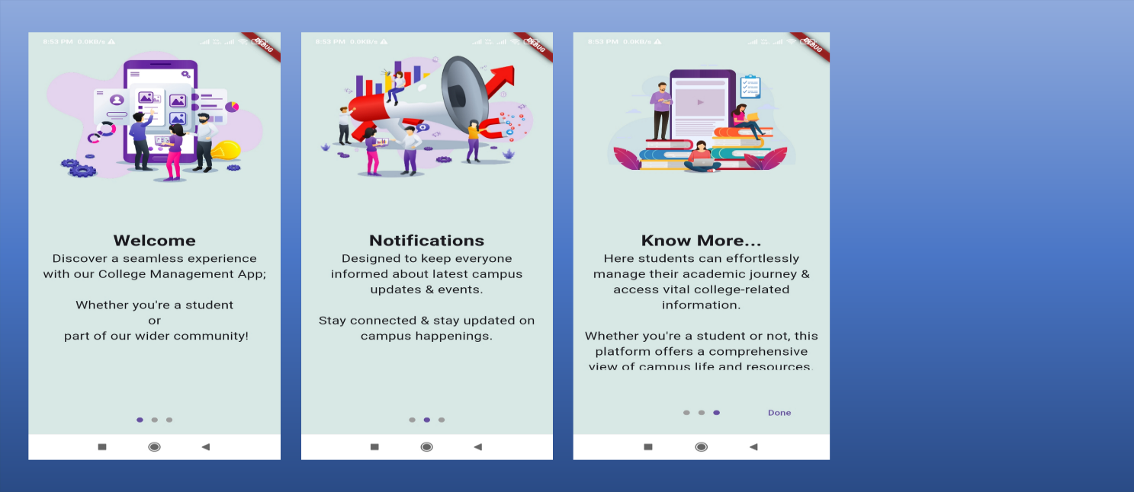
APP SCREESNSHOTS
Onboarding Screens:

Slide 18
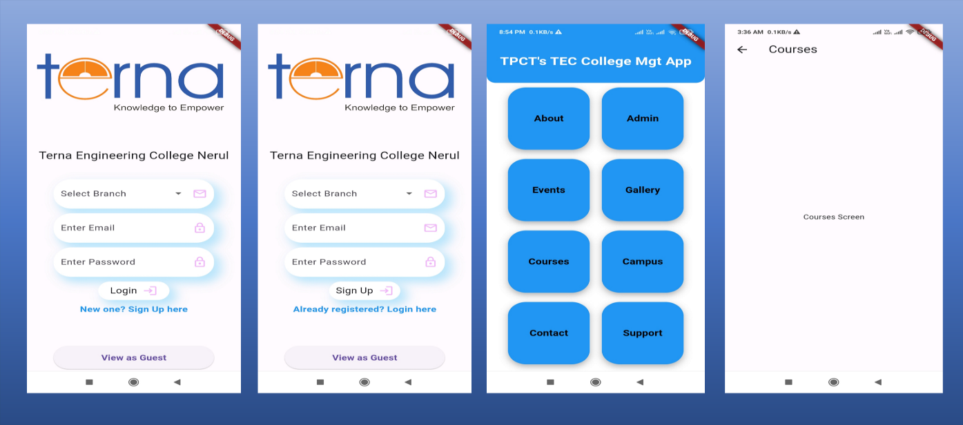
APP SCREESNSHOTS
Student Authentication Screens:

Slide 19
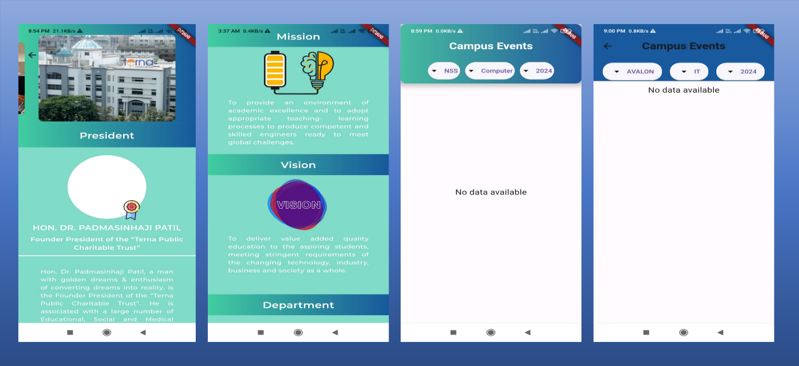
APP SCREESNSHOTS
College Profile Screens:

Slide 20
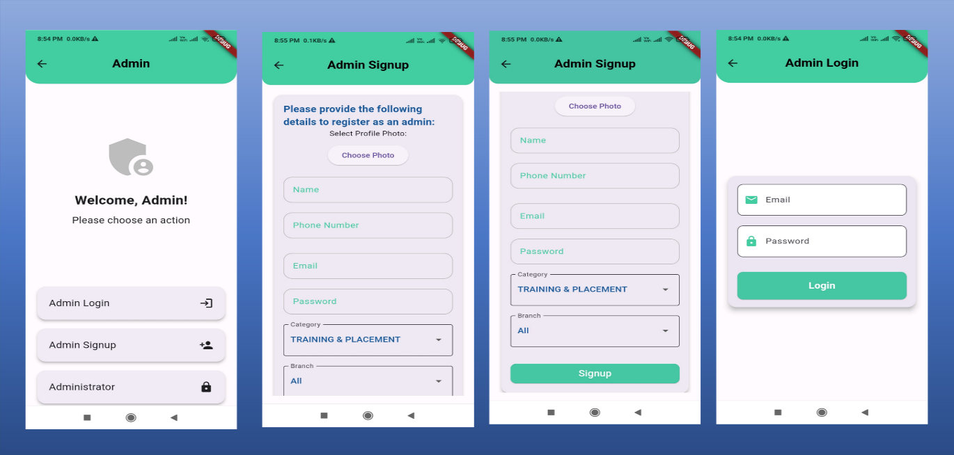
APP SCREESNSHOTS
Admin Authentication Screens:

Slide 21
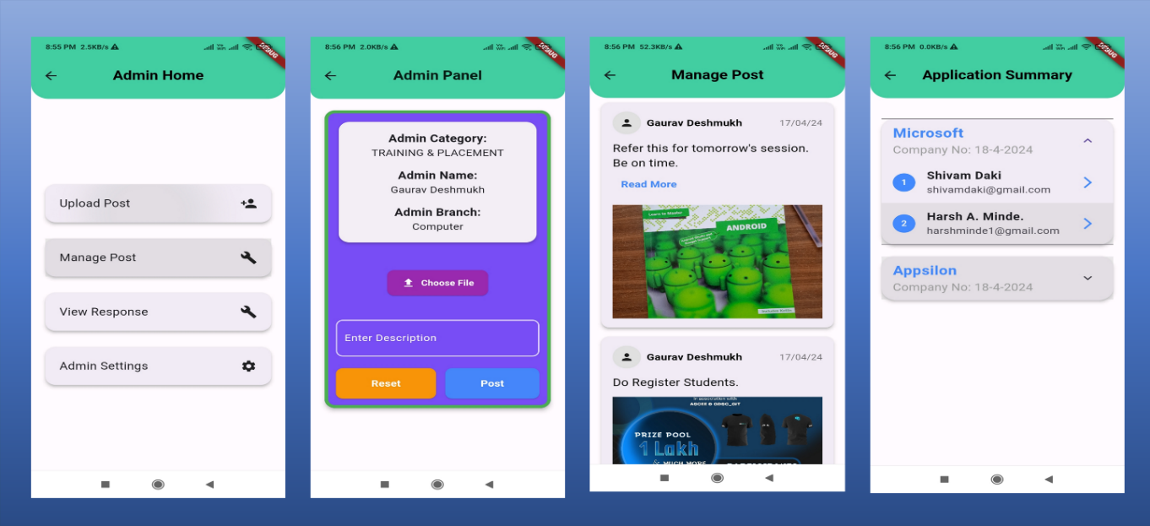
APP SCREESNSHOTS
Admin Home Screens:

Slide 22
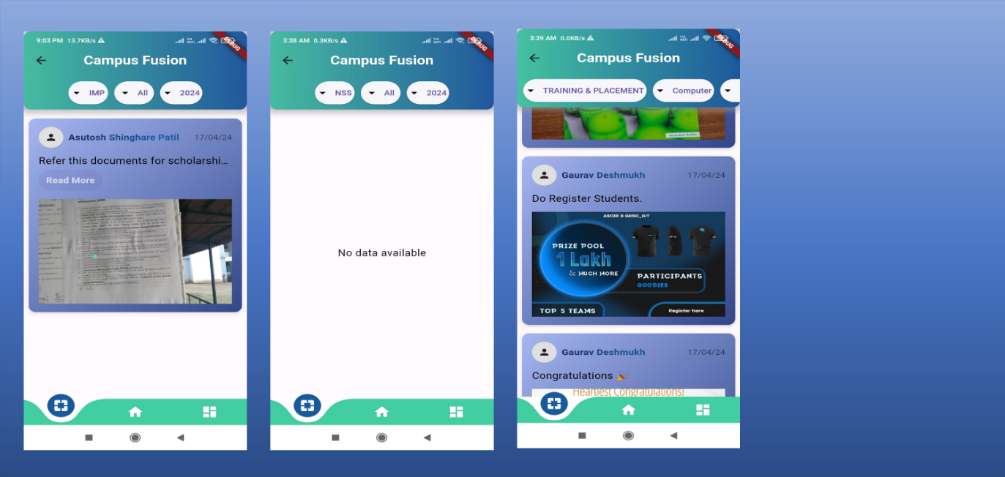
APP SCREESNSHOTS
Campus Fusion Screens:

Slide 23
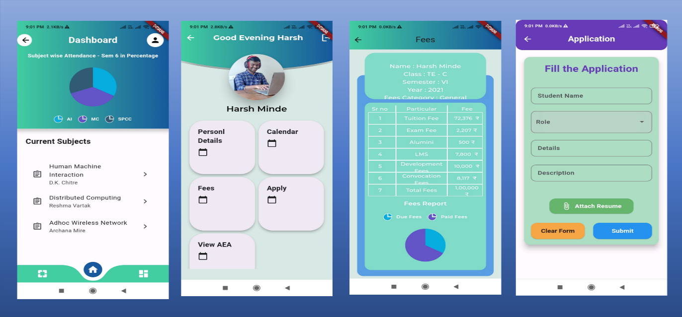
APP SCREESNSHOTS
Student Home Screens:

Slide 24
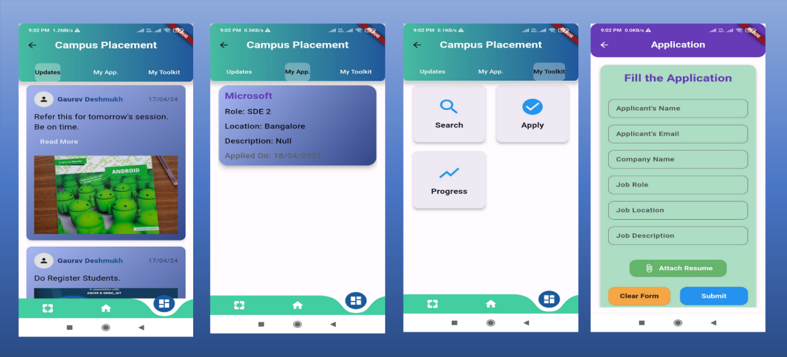
APP SCREESNSHOTS
Campus Placement Screens:

Slide 25
CONCLUSION & FUTURE SCOPE
CONCLUSION :
The core objective of providing efficient and immediate assistance to students and creating a user-friendly interface for ease of all committees and TnP cell to provide students with details about events, notices, fest or company and whether their eligibility criteria has been achieved successfully.

Slide 26
FUTURE SCOPE :
Integration of AI to analyze student records and skills to find him an optimal company to join.
Backup process can be comprised to make sure of data integrity.
The college’s exam cell can also be included in our system
The system can be expanded to include a discussion forum where alumini students, current students, and staff members can participate.

Slide 27
REFERENCE
Gunjan Jewani, Swati Sahare. “Online Training and Placement System”, IEEE International Students’ Conference on Electrical, Electronics and Computer Science, 10.1109, 2023.
Vivendra Yadav, Tushar Shende, “Place In Android Application For Student Placement System”, Journal of emerging Technologies and Innovative Research, June 2019, Volume 6, Issue 6.
Aditya Shelar, Sudarshan Sawant, “College Management System”, International Journal of Advanced Research in Science, Communication and Technology, May 2023, Volume 03, Issue 05.
Akshay Thete, Rucha Chaudhary, “IOS and Android Application for Training and Placement Department”, International Journal of Innovative Research in Technology, June 2021, Volume 08, Issue 01.
Shwetashree A, Bapuram Ramesh Rohith, “College Management Android Application”, International Research Journal of Modernization in Engineering Technology and Science, July 2022, Volume 04, Issue 07.
Niharika Dedhia, V. C. Kotak, “Android Based Campus Solution for College Management System”, International Journal of Computer Science and Mobile Computing, November 2017, Volume 06, Issue 11.

Slide 28
REFERENCE
7) Swapnali Avhad, Trupti Bade, “Design and Implementation of College Student Information Using Android Application”, International Research Journal of Engineering and Technology(IRJET), July 2020, Volume: 07, Issue: 07.
8) Farheen Taqi Rizvi, Naushin Arif Khan, “Placement Management System”, International Journal for Research in Applied Science and Engineering Technology(IJRASET), Jan 2021, Volume: 09, Issue: 01.
9) Aarti J. Auti, Varsha N. Pabale, “College Placement Recruitment System using Android App”, International Journal of Research Publication and Reviews(IJRPR), November 2023, Volume: 04, Issue: 11.

Slide 29
Thank You !!

